Slide 1
Watch-and-help a challenge for social perception and human-ai collaboration
Presenter: Massimo stefan

Slide 2


INDEx
INTRODUCTION
The watch-and-help challenge
The Virtualhome-social environment
The Eval. Protocol & benchmark
Results
Recap & conclusions
questions

Slide 3
intro
❓Problem: AI systems lack at recognizing others’goals and assisting them
💡 Idea: develop AI agents with social perception and collaborative planning abilities
🎯 Goal: test the social intelligence of AI agents
📄 Social perception: the ability to use the behavior, appearance, and communication of others to form opinions or make inferences about them, especially regarding their motives, attitudes, or values
📄 Human-AI collaboration: the study and practice how humans and AI agents work together to accomplish a shared goal
They main contributions are:
The Watch-and-Help (WAH) challenge
The VirtualHome-Social environment
The evalutation protocol and benchmark for the challenge

Slide 4
The Watch-and-Help challenge

Slide 5
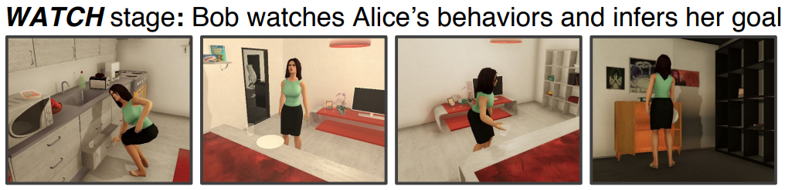
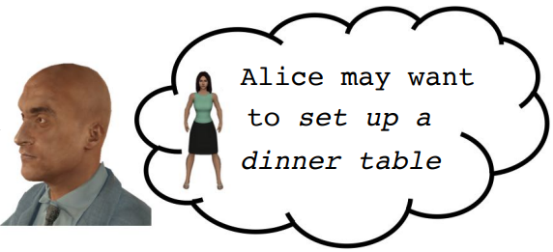
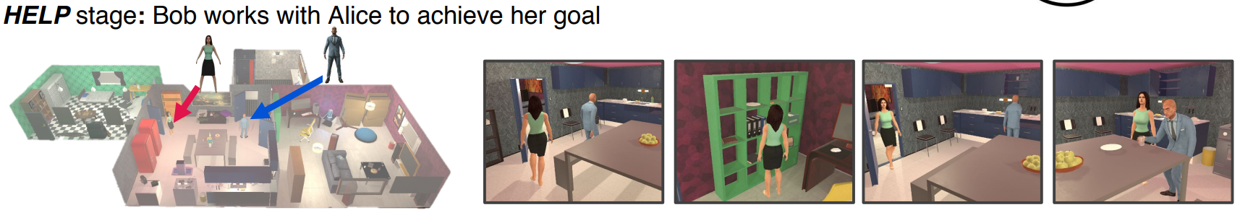
Watch-and-help challenge
🎯 Goal: evaluate AI agents’ social perception and their ability to collaborate with others
👀 Watch stage
The AI agent (Bob) observes a human-like agent (Alice) performing a task once and infers Alice’s goal from her actions.
🆘 help stage
Bob assists Alice in achieving the same goal in a different environment as quickly as possible.

Slide 6
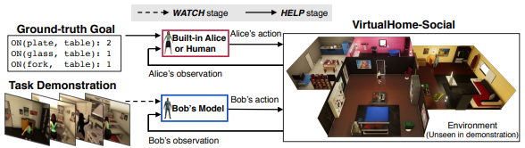
📜 Specifications 📜
Alice is built-in into the system → plans her actions based on her goal and partial observation of the environment
Bob is an external agent → does not know Alice’s ground-truth (GT) goal and only has access to a single observation
ONLY during training the GT goal of Alice is shown to Bob as supervision (at test time has to infer it)

Slide 7
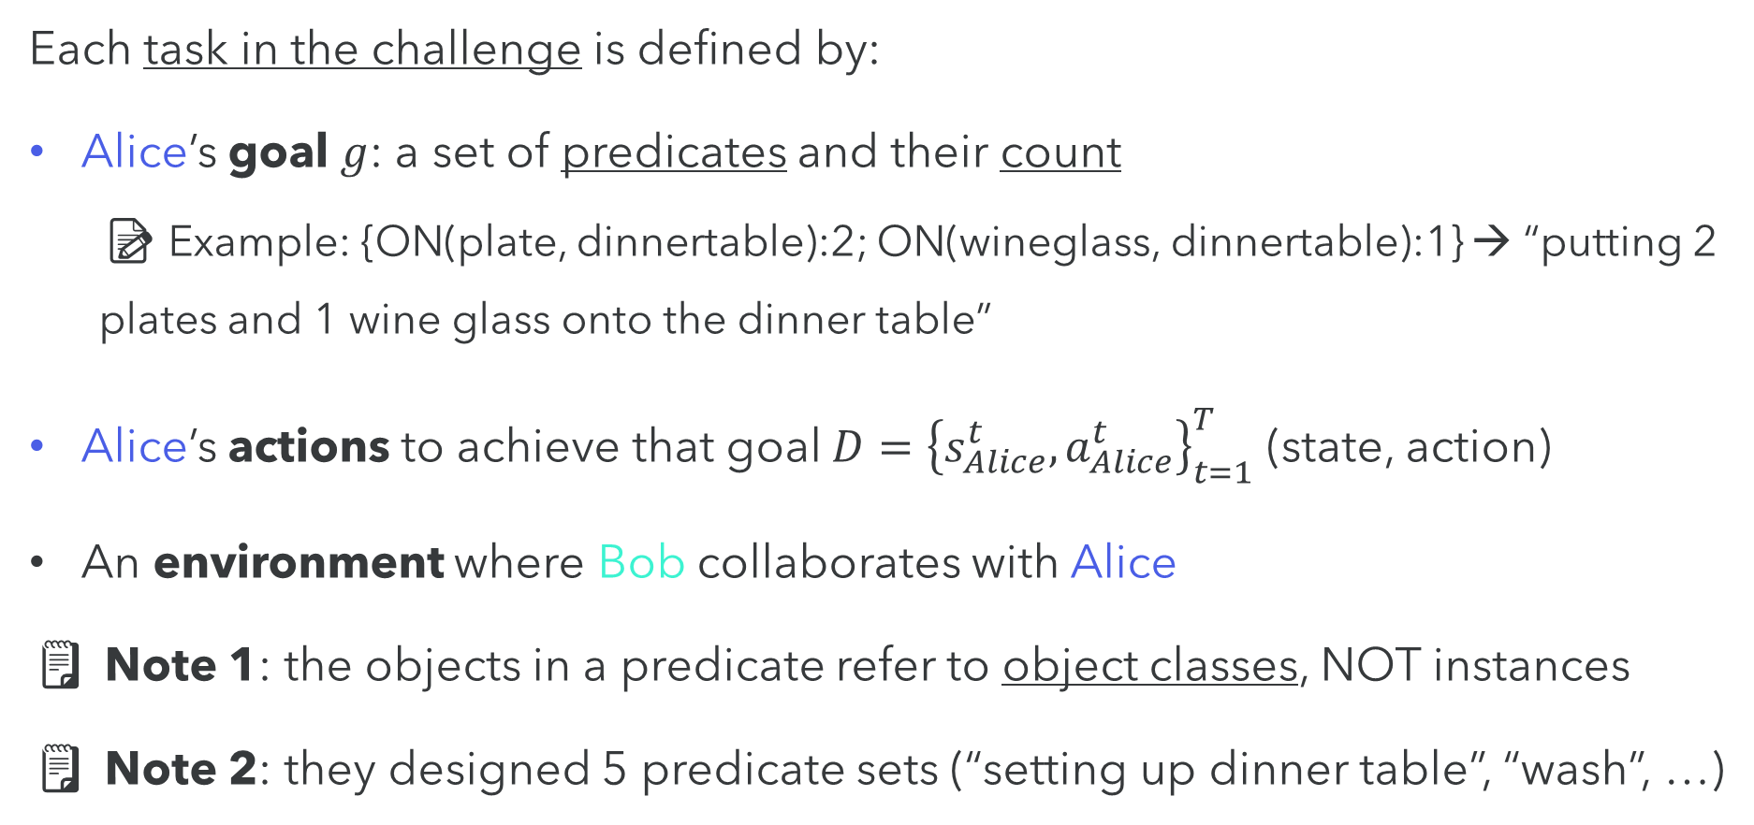
🤔 PROBLEM SETUP 🤔
Each task in the challenge is defined by:
Alice’s goal $g$: a set of predicates and their count
📝 Example: {ON(plate, dinnertable):2; ON(wineglass, dinnertable):1} → “putting 2 plates and 1 wine glass onto the dinner table”
Alice’s actions to achieve that goal $D={\left\{s_{Alice}^{t}, a_{Alice}^{t}\right\}}_{t=1}^{T}$ (state, action)
An environment where Bob collaborates with Alice
🗒️ Note 1: the objects in a predicate refer to object classes, NOT instances
🗒️ Note 2: they designed 5 predicate sets (“setting up dinner table”, “wash”, …)

Slide 8
The VirtualHome-Social environment

Slide 9
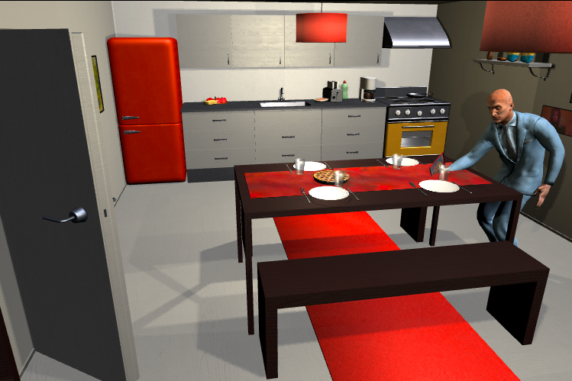
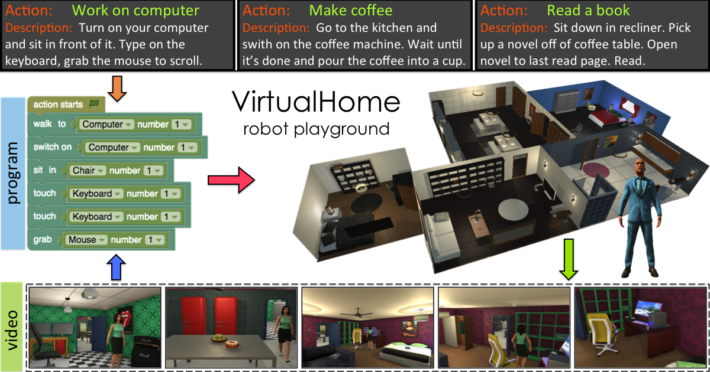
Virtualhome-social
🎯 Goal: allow AI agents to perform complex household tasks by interacting with objects and with built-in agents or real humans
🖐🏻 Objects and agents interactions
Simulate realistic home environments where agents can interact with objects and other agents.
⚙️ Built-in functions
built-in agents that emulate human behaviors
an interface for human players
supports concurrent actions from multiple agents
provides observations for the agents

Slide 10
📜 Specifications 📜
The environment supports symbolic (a scene graph where nodes represent objects and edges spatial relationships between them) and visual observations ⚠️ Warning: they do NOT specify how Bob process the visual input
The environment provides a large and diverse action space for agents 🗒️ Note: it changes at every step, based on the agent’s state

Slide 11
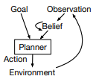
🤖 human-like agents 🤖
Agents operates on the symbolic representation, relying on:
A belief of object locations in the environment
A hierarchical planner, which uses Monte Carlo Tree Search (MCTS) and Regression Planning (RP)
to find a plan for a given goal based on its belief
🗒️ Note: permit to plan concurrently with other agents

Slide 12
The evaluation protocol and benchmark

Slide 13
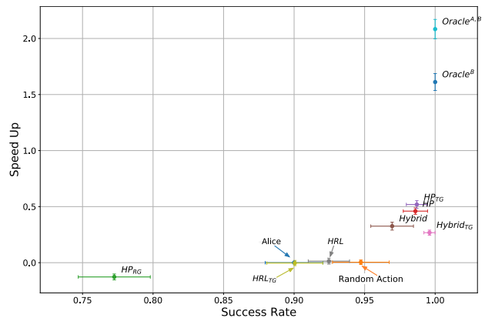
Eval. Protocol and benchmark
🎯 Goal: evaluate the WAH challenge in realistic settings at scale
📃 Evaluation protocol
Defines:
the training and testing setup
the goal definitions
the metrics
of the AI agents.
✅ benchmark
Provides a set of baseline models that consist of a goal inference model and a helping policy or planner, as well as 2 oracles that show the upper bound performance.

Slide 14
📜 Specifications 📜
The training set is composed by 1011 tasks
The test set is composed by 2 sets (test-1 and test-2) each with 100 tasks
With different environments (different apartments with random initial stage)
With different goals (predicate combinations) unseen during training
In test-1 → all predicates in each goal are from the same predicate set 📝 Example: “preparing a simple meal”
In test-2 → predicates are sampled from 2 different predicate sets 📝 Example: “putting groceries to the fridge and washing dishes”

Slide 15
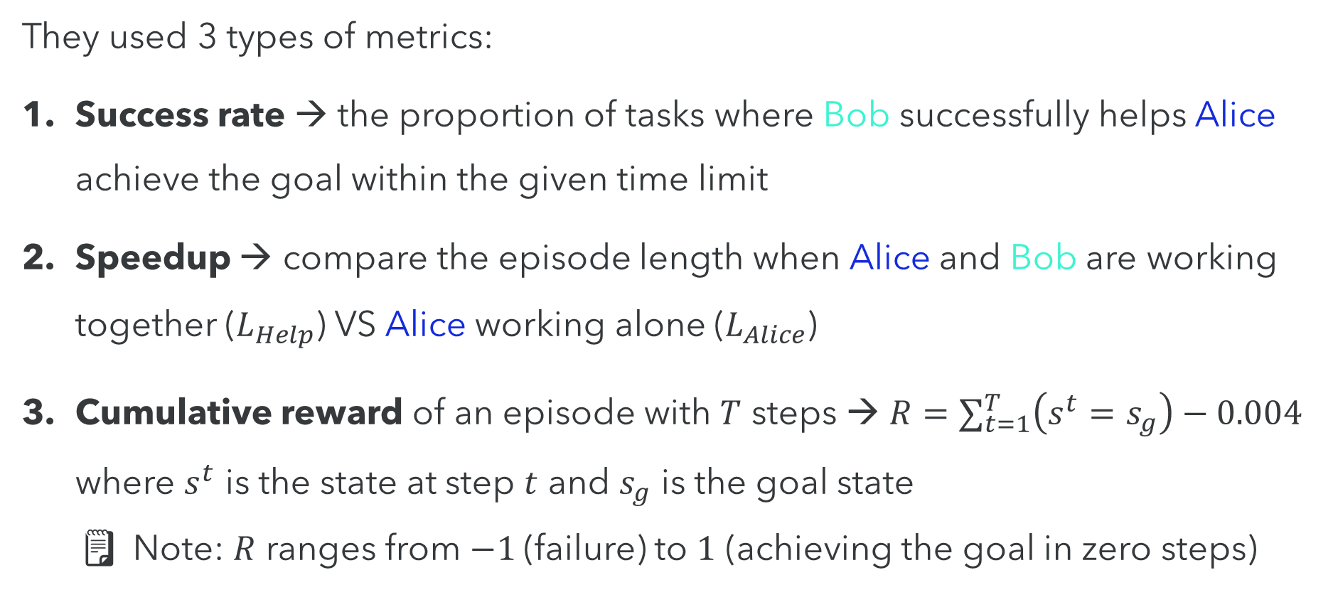
📐 evaluation metrics 📐
They used 3 types of metrics:
Success rate → the proportion of tasks where Bob successfully helps Alice achieve the goal within the given time limit
Speedup → compare the episode length when Alice and Bob are working together ($L_{Help}$) VS Alice working alone ($L_{Alice}$)
Cumulative reward of an episode with $T$ steps → $R=∑_{t=1}^{T}\left(s^{t}=s_{g}\right)−0.004$ where $s^{t}$ is the state at step $t$ and $s_{g}$ is the goal state 🗒️ Note: $R$ ranges from $−1$(failure) to $1$ (achieving the goal in zero steps)

Slide 16
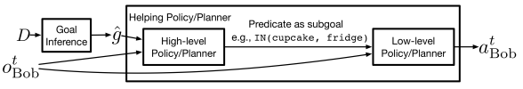
📉 baselines 📉
The set of baselines consist of 2 components:
Goal inference model: trained based on the symbolic representation of states in the demonstration. At each step:
Encode the state using a Transformer (over visible objects)
Feed the encoded state into a LSTM
Use average pooling to aggregate the latent states from the LSTM over time
Build a classifier for each predicate to infer its count (30 classifiers)

Slide 17
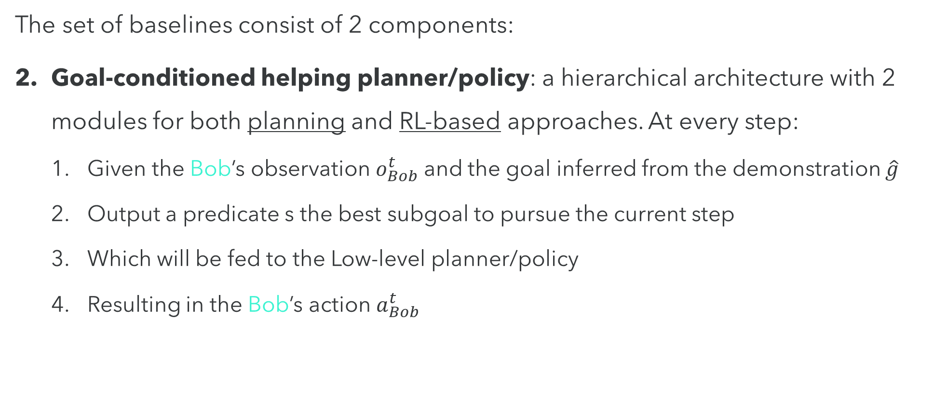
📉 baselines 📉
The set of baselines consist of 2 components:
Goal-conditioned helping planner/policy: a hierarchical architecture with 2 modules for both planning and RL-based approaches. At every step:
Given the Bob’s observation $o_{Bob}^{t}$ and the goal inferred from the demonstration $\hat{g}$
Output a predicate s the best subgoal to pursue the current step
Which will be fed to the Low-level planner/policy
Resulting in the Bob’s action $a_{Bob}^{t}$

Slide 18
📉 baselines 📉
The baseline models follows different policies:
HP: a selects actions based on predefined rules and heuristics
Hybrid: combines handcrafted policy with a NN policy traned with SL
HRL: HL policy selects subgoals, LL policy selects actions to achieve them
Random: selects actions uniformly at random
Oracle^{B}: selects the best action according to the GT reward function
Oracle^{A,B}: selects the best action according to the GT reward function and the GT truth user state

Slide 19
results

Slide 20
🏆 test-1 results 🏆
🎯 Goal 1: evaluate the 👀 stage (predict the goal predicates)
🔍 How: measuring the recognition performance of the predicates
📈 Results: precision of 0.85 and recall of 0.96 (👍🏻)
🗒️ Note 1: performs better when it sees the full demonstration rather than just the last observation of the actions taken by Alice
👁️ Remark: the model can learn from the temporal and causal structure of the demonstration, not just from the final outcome
🗒️ Note 2: the chance precision and recall is 0.08 and 0.09

Slide 21
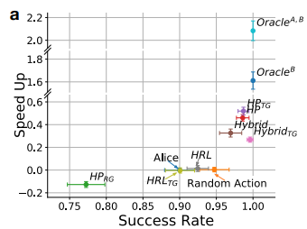
🏆 test-1 results 🏆
🎯 Goal 2: evaluate the 🆘 stage (predict the goal predicates)
📈 Results:
Planning-based approaches (Oracle, HP, Hybrid) are the most effective
DRL does not work well for Bob (fails to achieve the subgoals)
No significant difference between Random actions and Alice working alone
Using the inferred goals (HP and Hybrid) works well
But, with a random goal inference (HP_{RG}) becomes counter productive

Slide 22
🏆 test-2 results 🏆
🎯 Goal 1: evaluate the 👀 stage (predict the goal predicates)
🔍 How: measuring the recognition performance of the predicates
📈 Results: precision of 0.68 and recall of 0.64 (👎🏻)
🗒️ Note: the model fails to generalize to multi-activity scenarios, overfitting to prediate combinations seen during training

Slide 23
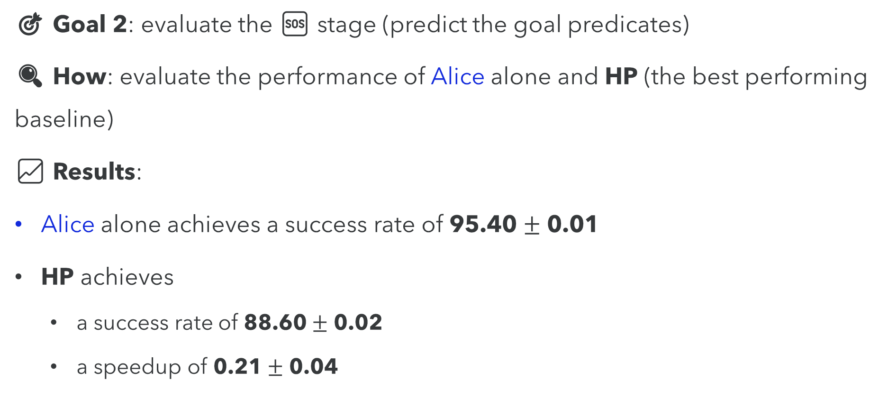
🏆 test-2 results 🏆
🎯 Goal 2: evaluate the 🆘 stage (predict the goal predicates)
🔍 How: evaluate the performance of Alice alone and HP (the best performing baseline)
📈 Results:
Alice alone achieves a success rate of 95.40 $±$ 0.01
HP achieves
a success rate of 88.60 $±$ 0.02
a speedup of 0.21 $±$ 0.04

Slide 24
THANK YOU
Massimo Stefan
Paper pdf and GitHub links
Questions link

